Slide 1
Automated Development Authority

Slide 2
Contents
Subsystems
According to each subsystem
  Collaboration diagram for each use case
  Class diagram for each use case

Slide 3
Subsystems
Form Submission and File Formation
Land Use Clearance
Building Permit
Special Project Permit
Appeal System
Complaint System

Slide 4
Subsystem 1:
Form Submission and File Formation

Slide 5
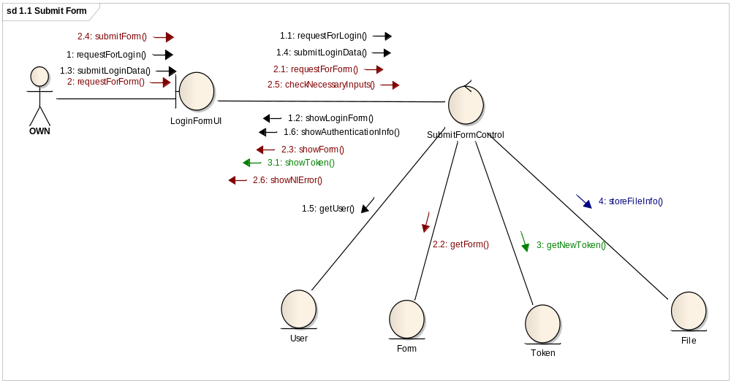
1.1 Submit Form

Slide 6
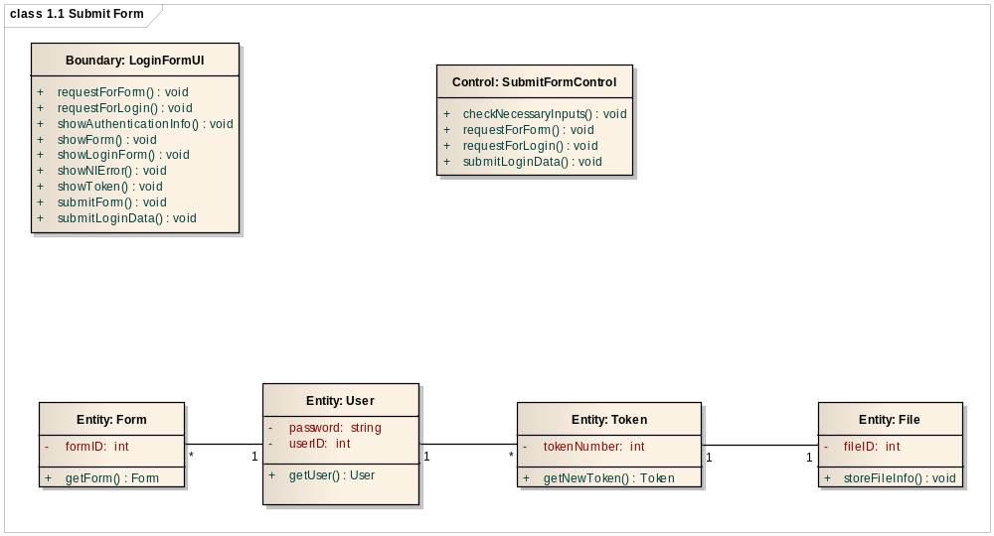
1.1 Submit Form

Slide 7
Subsystem 2:
Land Use Clearance System

Slide 8
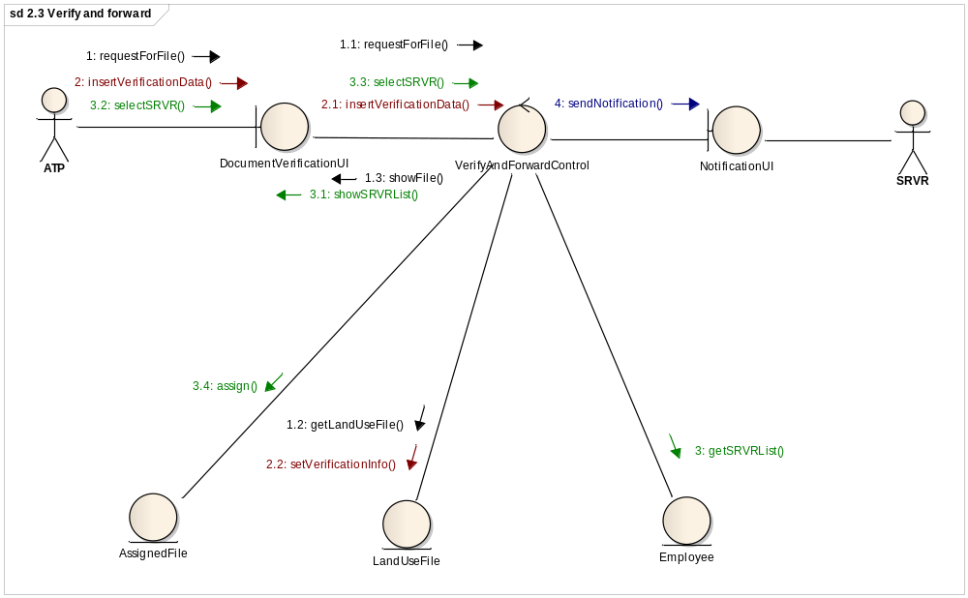
2.3 Verify And Forward

Slide 9
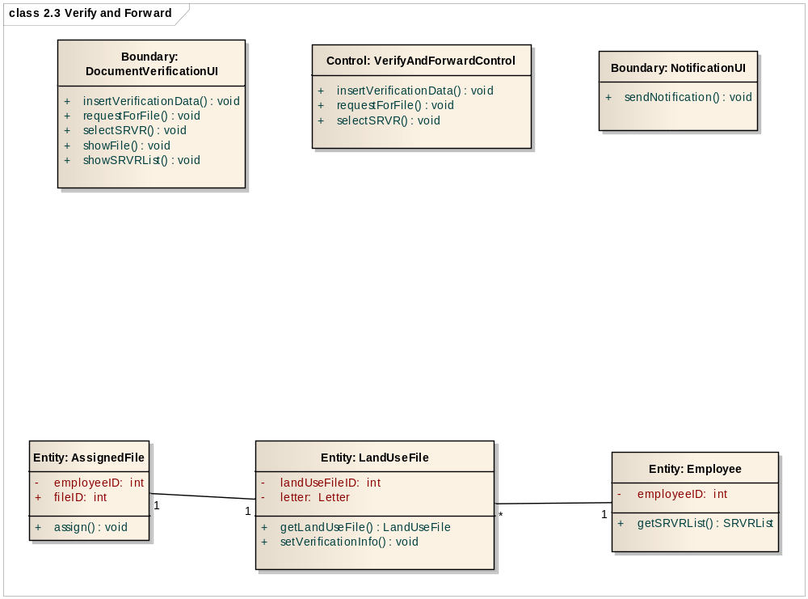
2.3 Verify And Forward

Slide 10
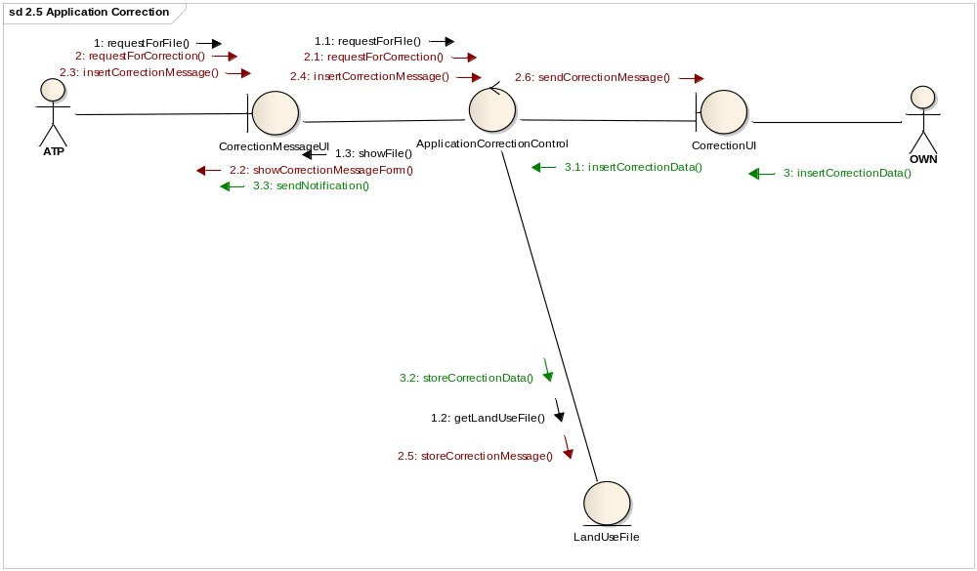
2.5 Application Correction

Slide 11
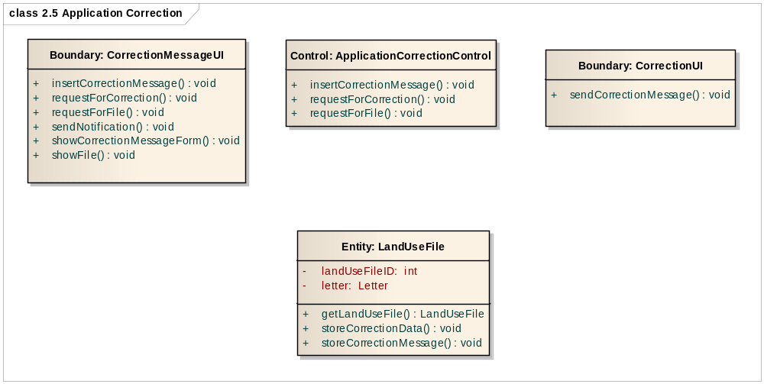
2.5 Application Correction

Slide 12
Subsystem 3:
Building Permit System

Slide 13
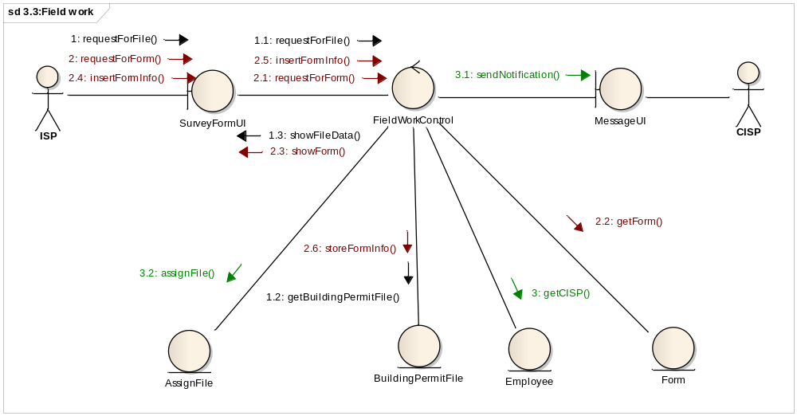
3.3: Field work

Slide 14
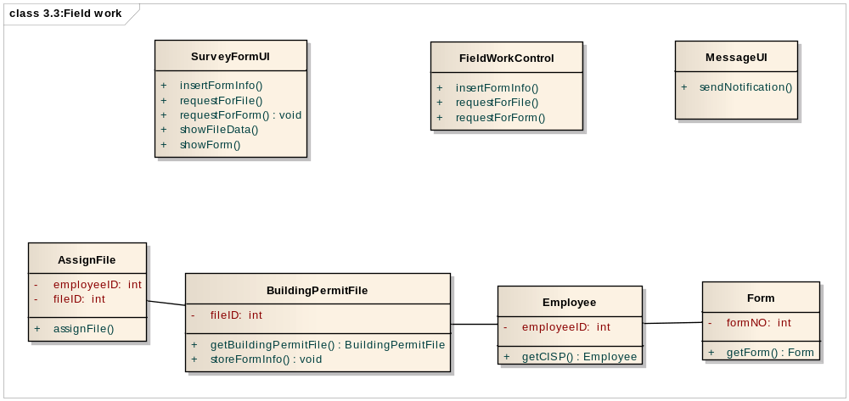
3.3: Field work

Slide 15
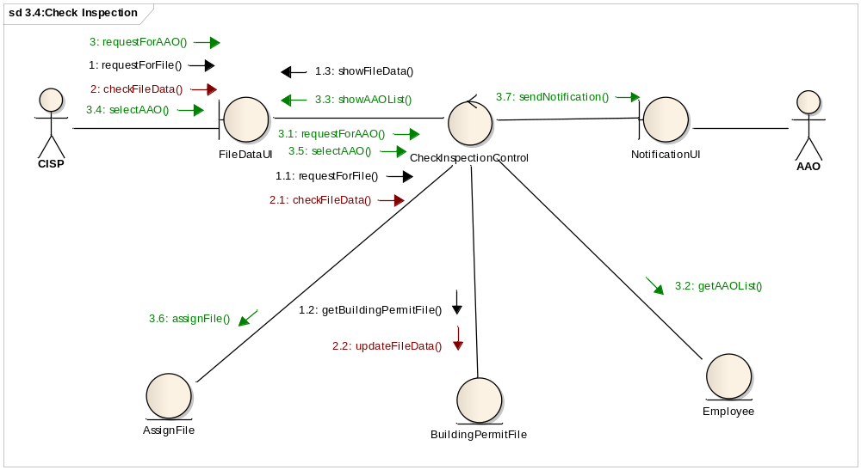
3.4: Check Inspection

Slide 16
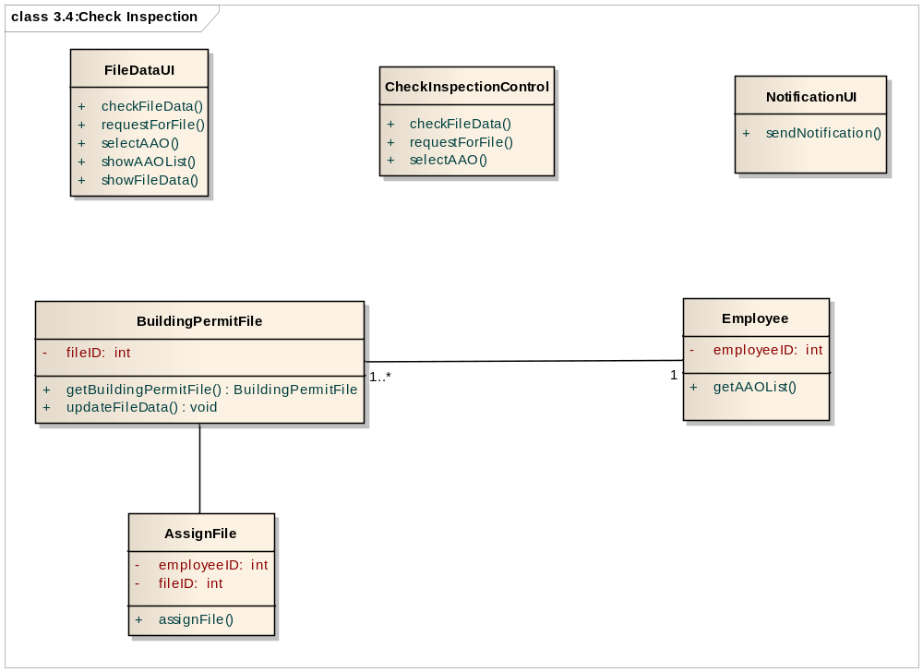
3.4: Check Inspection

Slide 17
Subsystem 4:
Special Project Permit System

Slide 18
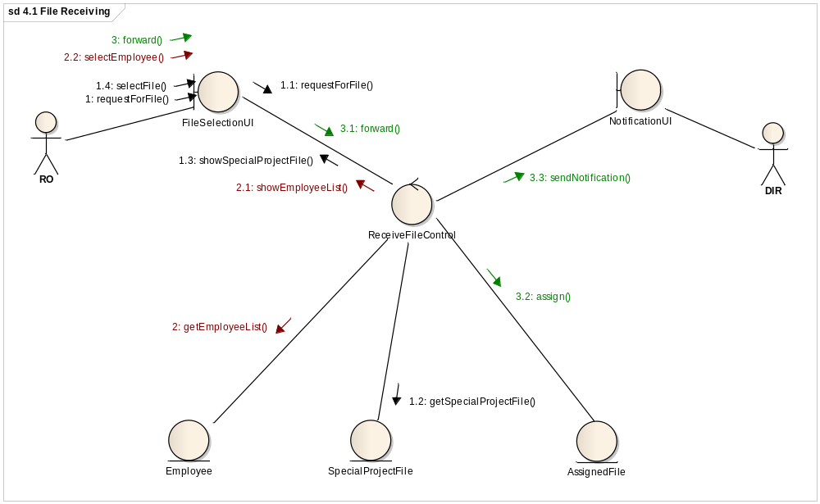
4.1 File Receiving

Slide 19
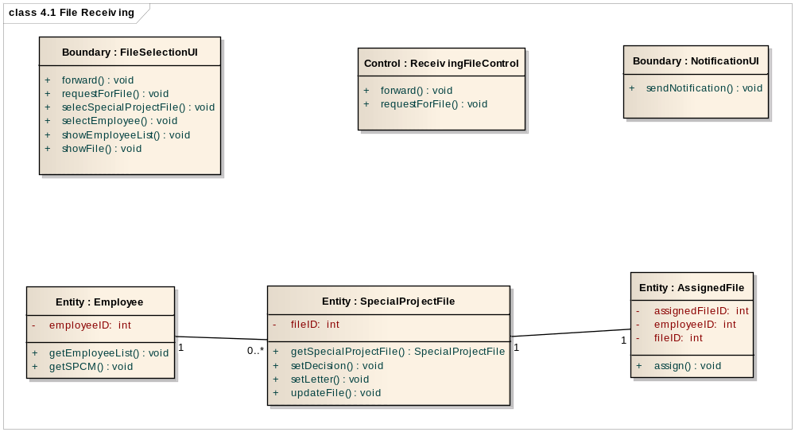
4.1 File Receiving

Slide 20
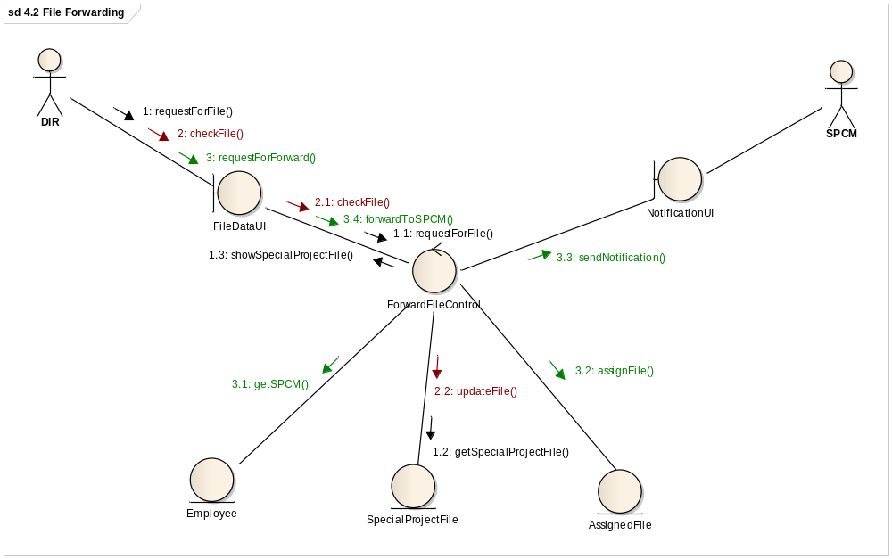
4.2 File Forwarding

Slide 21
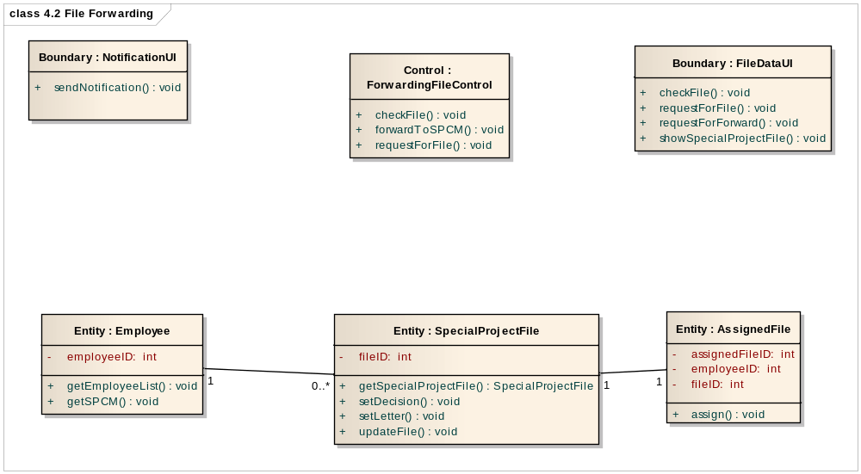
4.2 File Forwarding

Slide 22
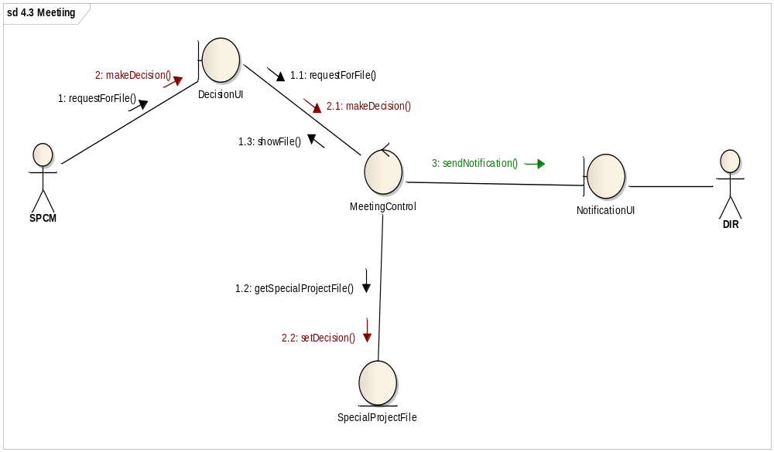
4.3 Meeting

Slide 23
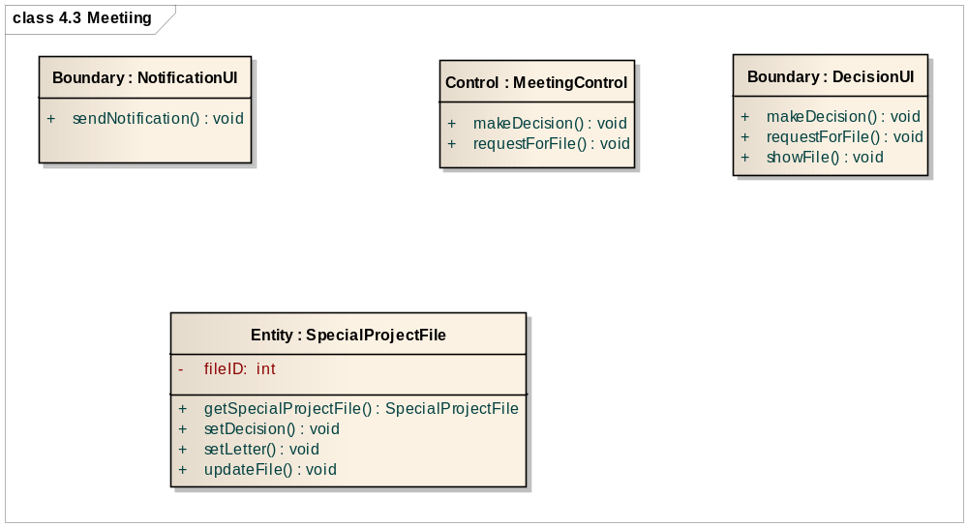
4.3 Meeting

Slide 24
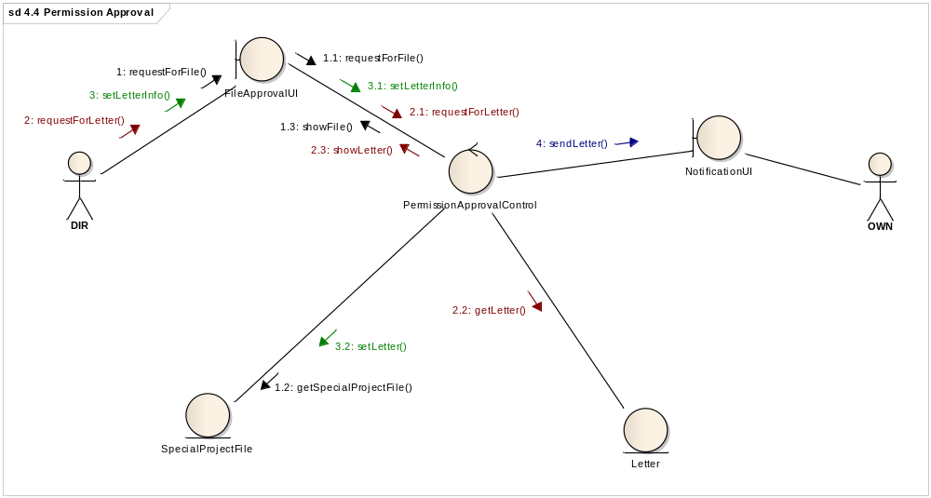
4.4 Permission Approval

Slide 25
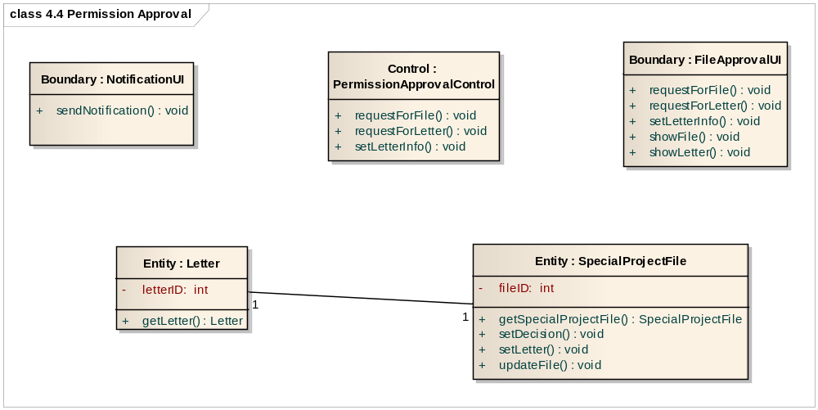
4.4 Permission Approval

Slide 26
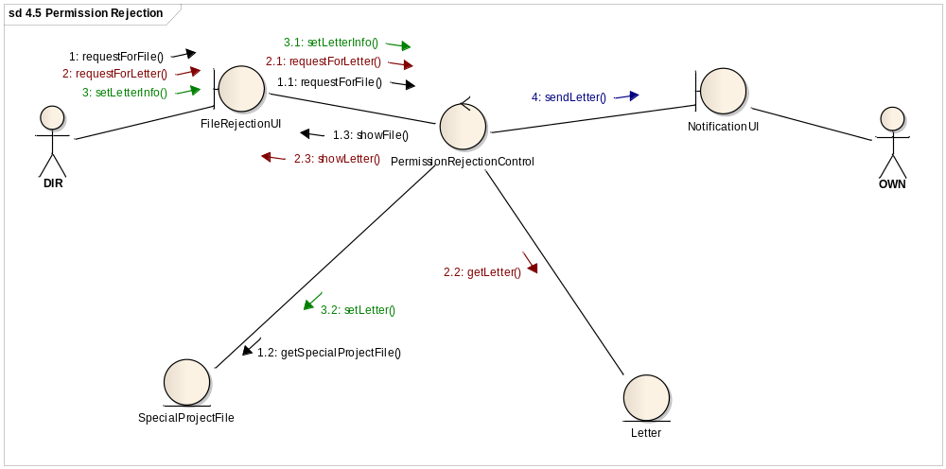
4.5 Permission Rejection

Slide 27
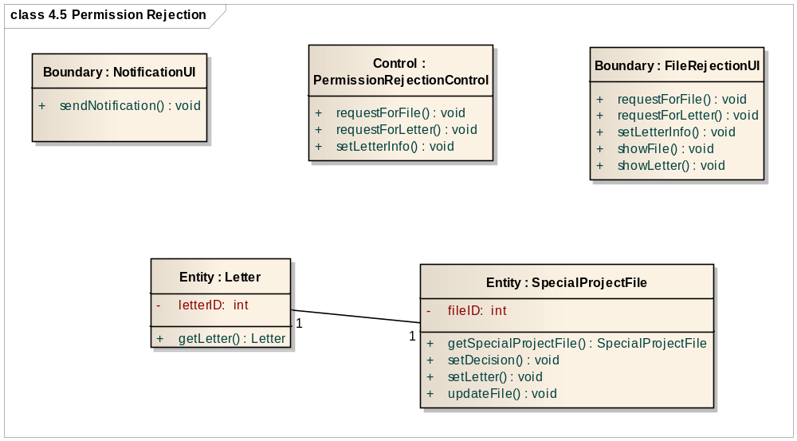
4.5 Permission Rejection

Slide 28
Subsystem 5:
Appeal System

Slide 29
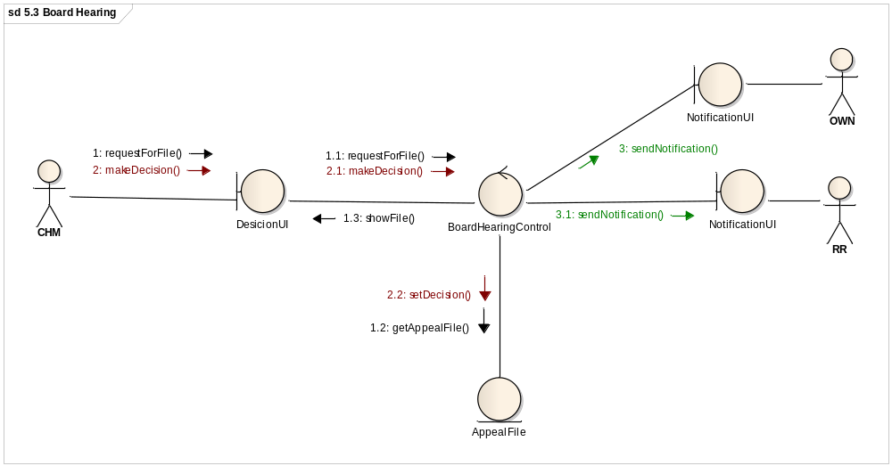
5.3 Board Hearing

Slide 30
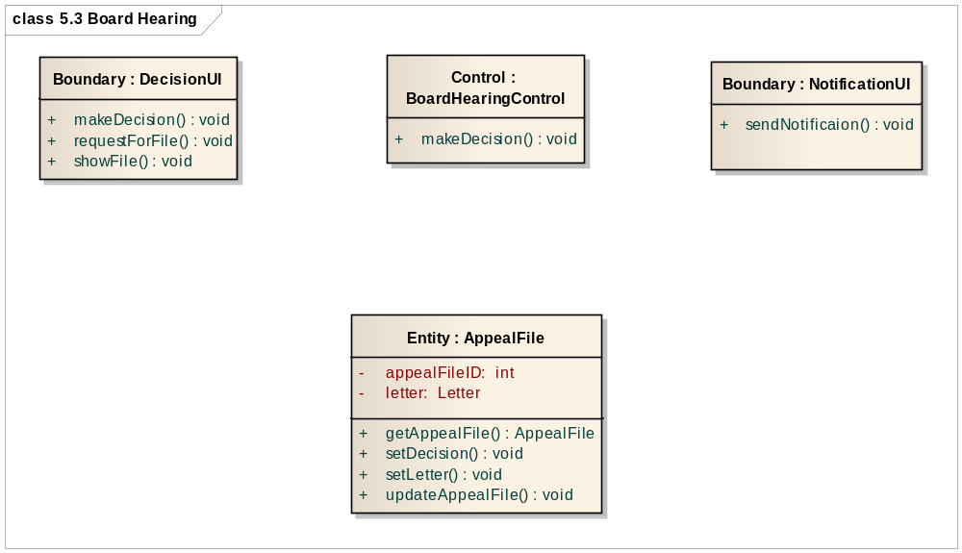
5.3 Board Hearing

Slide 31
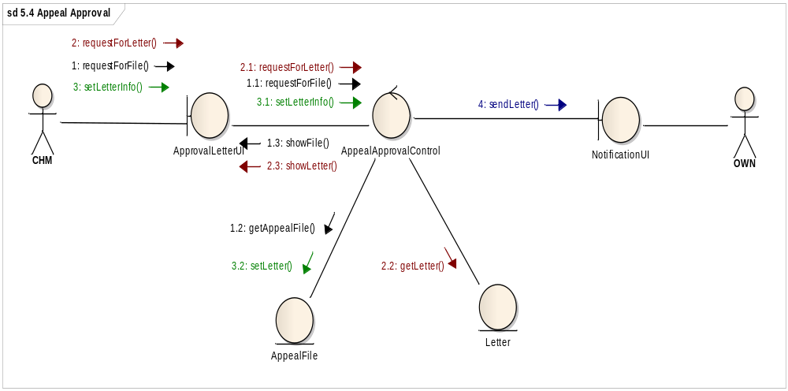
5.4 Appeal Approval

Slide 32
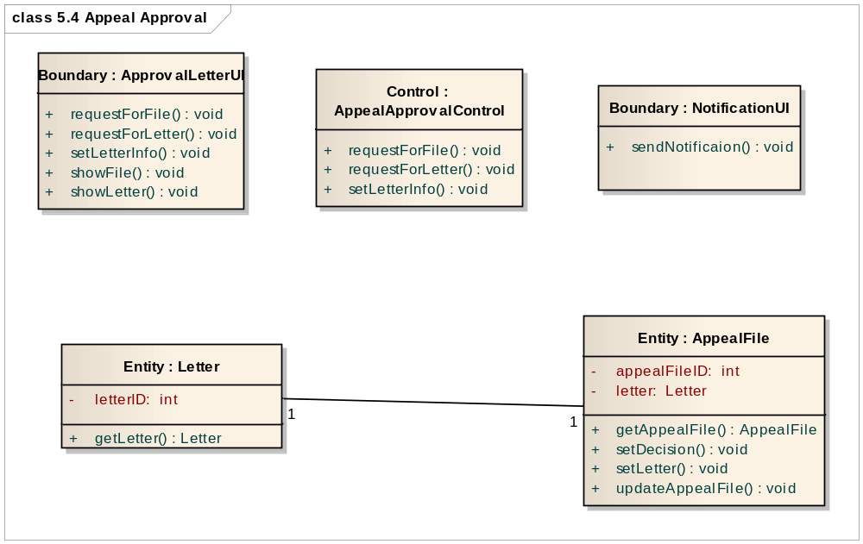
5.4 Appeal Approval

Slide 33
Subsystem 6:
Complaint System

Slide 34
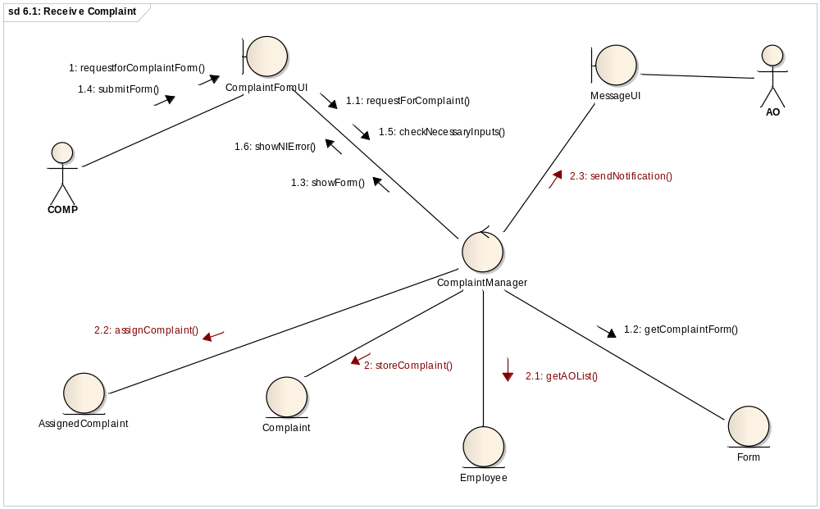
6.1: Receive Complaint

Slide 35
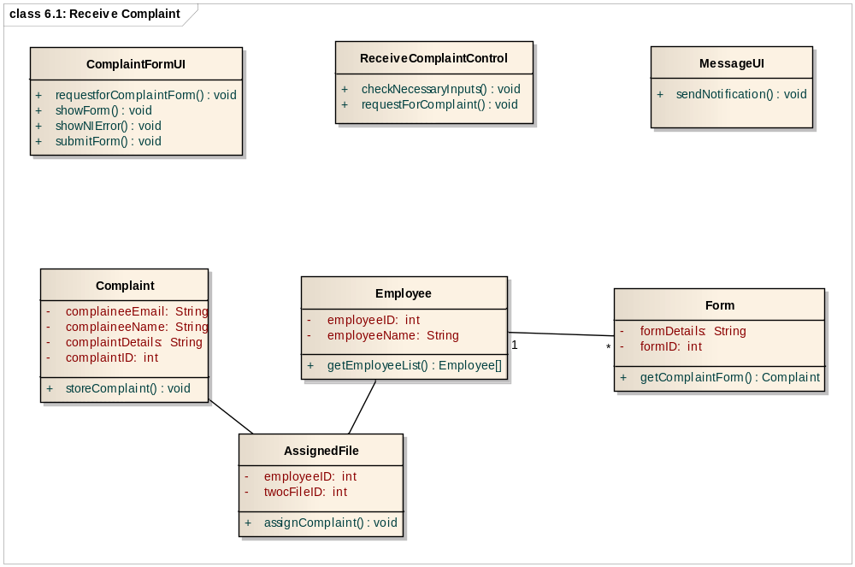
6.1: Receive Complaint

Slide 36
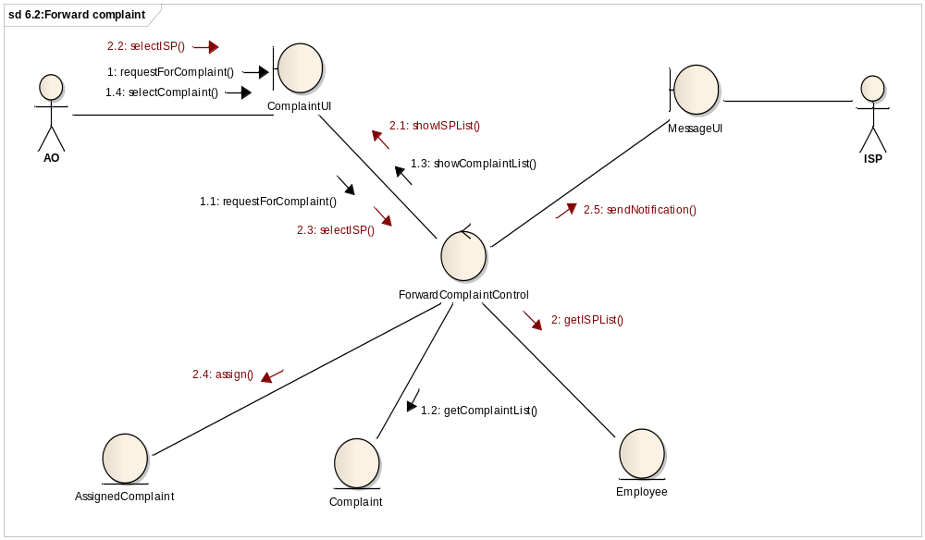
6.2:Forward complaint

Slide 37
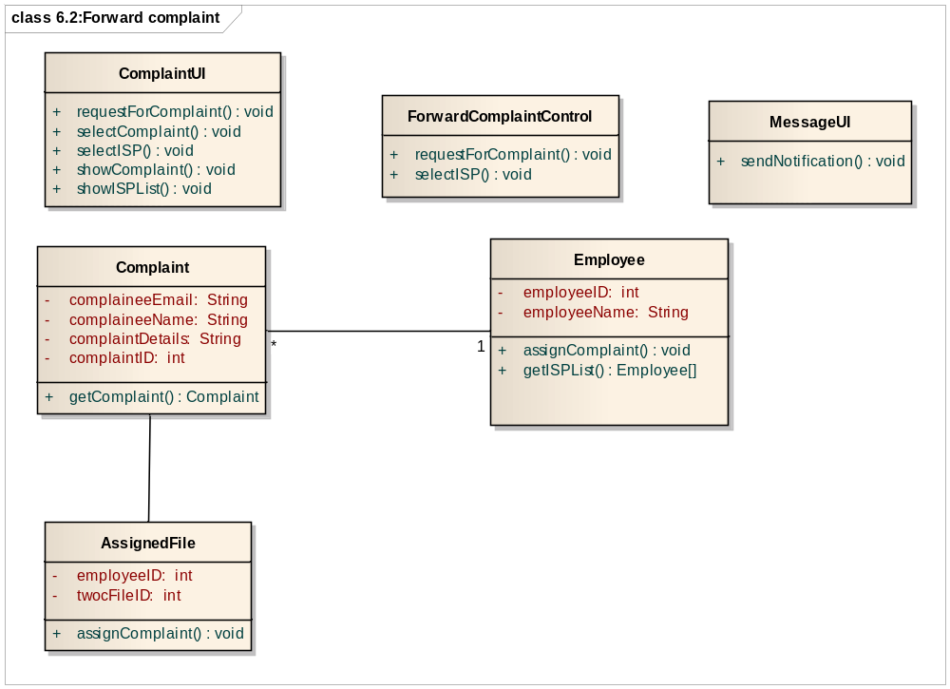
6.2:Forward complaint

Slide 38


